Slide 1


Cherries
02
Stages
01
03
Our Team
Eco Pirates
Used Technologies
04
The Game

Slide 2
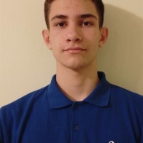

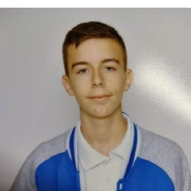

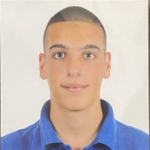
Table of content
01
02
03
Our Team
Stages
Used Technologies
04
The Game
Our team
Lazar Apostolov
Front-end developer
10B
Miroslav Ganev
Scrum trainer
10A
Georgi Ivanov
Teodor Tanev
Back-end developer
10V
Back-end developer
10G

Slide 3
Miroslav Ganev
Lazar Apostolov
Georgi Ivanov
Teodor Tanev
Stage 1: Creating logo and discussing ideas about the game
State 3: Implementing our game idea through code
Our team
Scrum trainer
10A
Front-end developer
10B
Back-end developer
10V
Back-end developer
10G
Stage 2: Making basic game’s design and creating our main character
Stage 4: Finishing the game and making documentation

Slide 4











Stages
State 3: Implementing our game idea through code
Stage 1: Creating logo and discussing ideas about the game
Stage 2: Making basic game’s design and creating our main character
Stage 4: Finishing the game and making documentation

Slide 5
Used Technologies

Slide 6
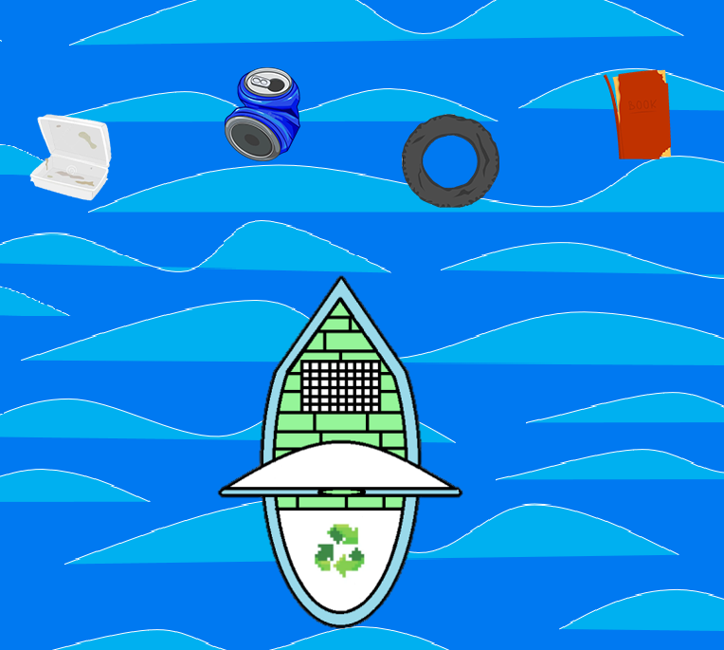
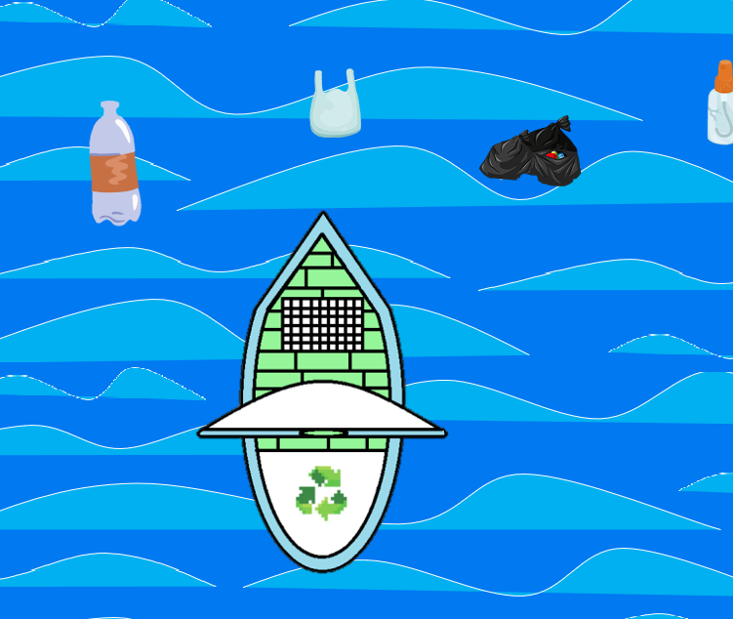
Let’s get to the game

